Slide 1

Temperature Monitoring System
By
2111CS050106 I.Venkata Hari
2111CS050090 P.Naveen
2111CS050072 Anand Charan
2111CS050117 S.Manideep
Under the Guidance of
Mrs.G.Sailaja
Assistant Professor
Department of Internet of Things
School of Engineering
Malla Reddy University
Hyderabad, Telangana, INDIA

Slide 2
ABSTRACT
Iot technology has enabled the development of useful application to improve the quality of life. We can also the need to develop other application to make an effective use of the devices and the internet connectivity. Our project trys to solve the problems occuring due to lack of monitoring of our goods. In this regard we have taken the first to solve the problem by proposing a project which can Monitior the temperature of goods present in an container and notify the person in-charge according to the constraints he/she have provided .For this project we will be using ESP8266 as the processing unit due to wireless wifi connectivity and upload HTML code to monitor temperature and daily usage of our model through the local network connected to the device.

Slide 3
1. Introduction
1.1 Problem Definition & Description
Problem specification
Methods to prevent lack of monitorinng
Problem description
The lack of monitoring of products can cause them to loose the quality of taste,may even cause harm to
the customers . There are various issues which can lead to distrust between customer and seller
1.2 Objectives of the Project
Aim of the project
To create a monitoring setup to prevent any issues related due to the unmonitored activities.
Tasks and deliverables
The ability to get notified when temperature falls a certain threshold
To keep a record of his daily activities

Slide 4
1. Introduction
1.3 Scope of the project
Determining goals
To determine the status of our device which is connected to a model.
Data & Constrains
Temperature sensing (Humidity and Temperature)
Workflow management strategies
Gathering requirements, efficient algorithm making for system working , testing

Slide 5
2. System Analysis
2.1 Existing System
Background & Literature Survey
The utilization of internet of Things application has not been applied to it.
Limitations of Existing System
Accidents are happening due to lack of noticing/monitoring .
2.2 Proposed System
Advantages of Proposed System
Immediate information sharing incase of changes in temperature

Slide 6
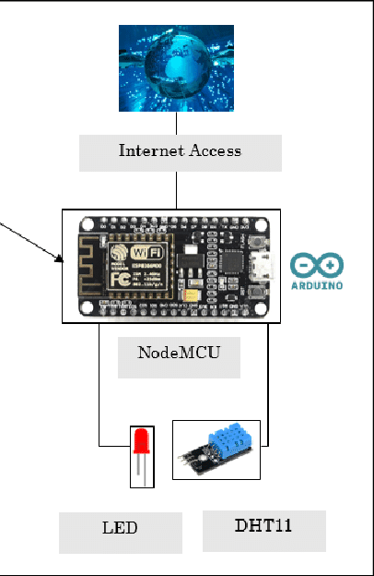
2.3 System Architecture

Slide 7
2. System Analysis
2.4 Software & Hardware Requirements
Software Requirements
HTML languauge
Arduino programming(C++)
Python
Hardware Requirements
Raspberry Pi
Neo-6M GPS
BME280 Module
LED’s
2.5 Feasibility Study
Technical Feasibility
Requires voluntary help from local vendor to decide the limitations.
Robustness & Reliability
Requires to be checked with battery percentage of charge which is being used to monitor.
Economic Feasibility
1000/- for the prototype

Slide 8
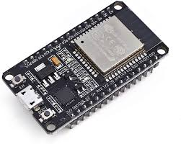
3.Architectural Design
3.1 Module Description:
ESP32 WROOM DEVKIT
esp32 is a microcontroller capable of processing information of upto 512 bytes. It has an inbuilt wi-fi and Bluetooth for communication. The ESP32 has total 38 pins including GPIO pins, Analog pins etc.,
ESP32 WROOM

Slide 9
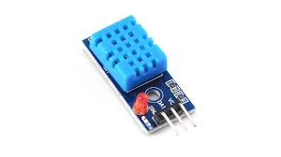
3.1.2 DHT11:
DHT is a sensor capable of measuring temperature and humidity, this sensor has an range of -40 °C to 100 °C and is used in various monitoring system.
DHT11 Sensor

Slide 10
3.2 Methodology:
3.2.1 How Temperature is Read:
Temperature is read through DHT11 sensor and is computed by esp32 and the data is updated to the web socket
if the dht11 sensor is unable to read the value then the temperature is updated with a nan value and updated to the web socket.
3.2.2 How the Web server works:
Through the usage of Async web browser we upload our code into the microcontroller. After successfully uploading the esp. connects to the Wi-Fi credentials provided and hosts the web page we can connect to the web page by entering the IP address into a commonly connected device.

Slide 11
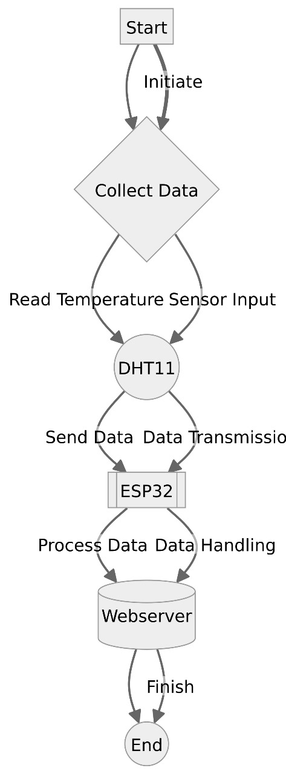
Data Flow Diagram

Slide 12
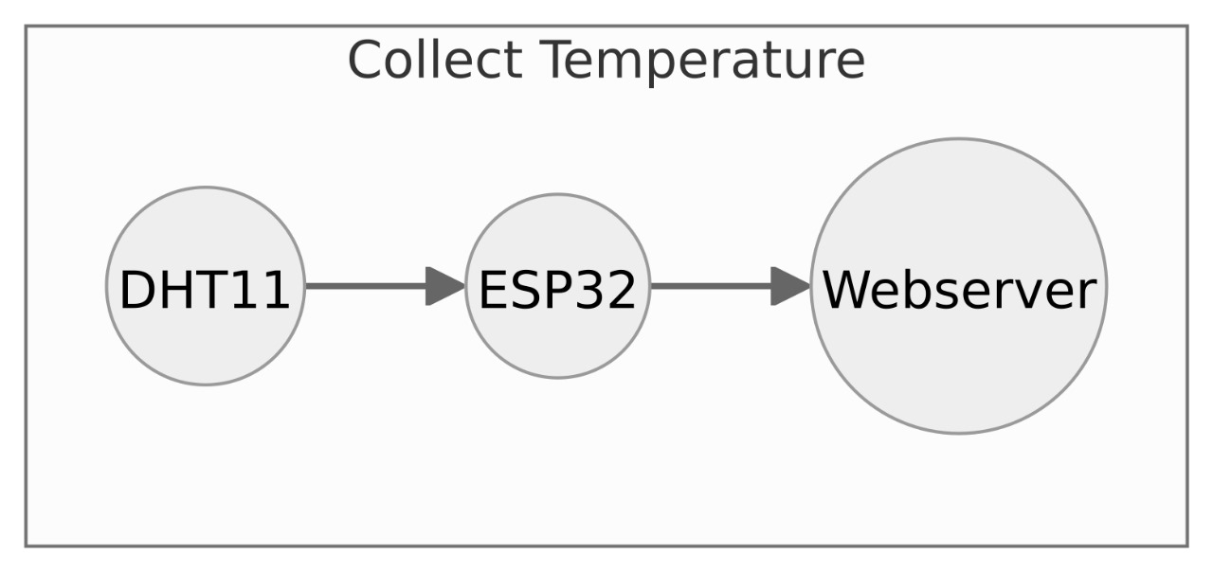

Slide 13
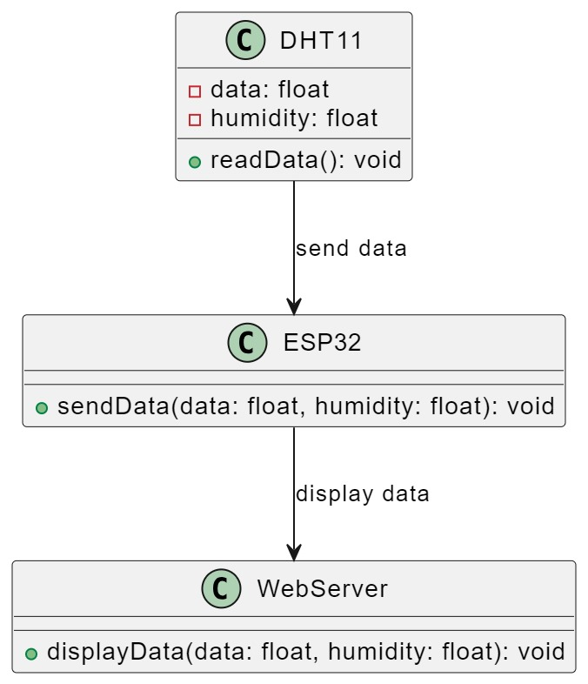
Class Diagram

Slide 14
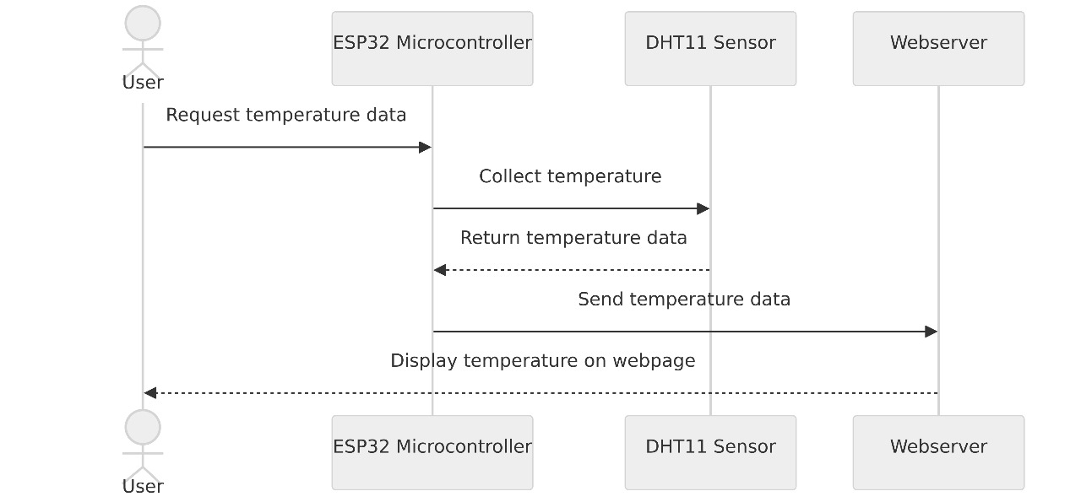
Sequence Diagram

Slide 15
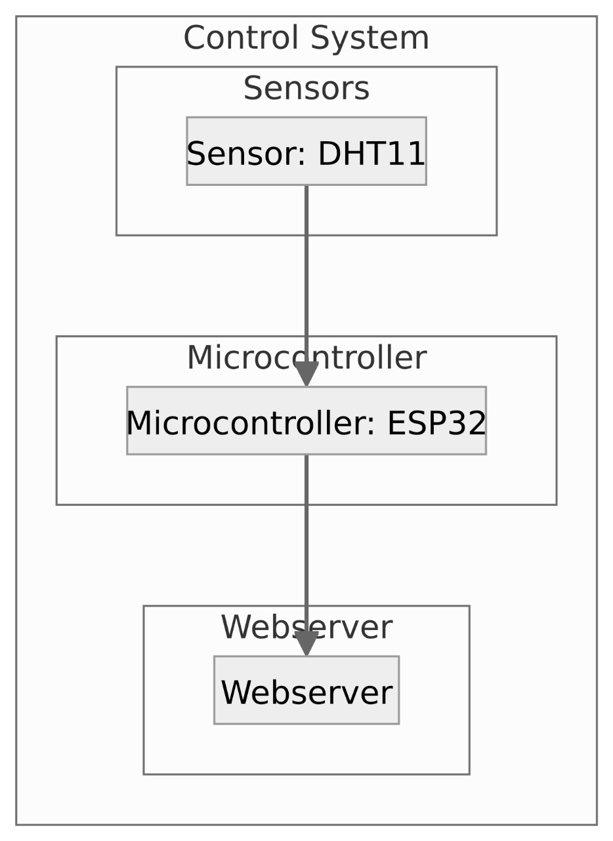

Slide 16
4. Implementation and Testing
4.1 Coding Blocks:
//#include <imagedata.h>
//#include <Roboto_Font.h>
//#include <WC_AP_HTML.h>
#include <WiFiConnectParam.h>
#ifdef ESP8266
#include <ESP8266WiFi.h>
#include <ESP8266mDNS.h>
#elif defined(ESP32)
#include <WiFi.h>
#include <ESPmDNS.h>
#else
#error "Board not found"
#endif
#include <WebSocketsServer.h>

Slide 17
#include <ArduinoJson.h>
//#include <DHT.h> //DHT and Adafruit Sensor library(https://github.com/adafruit/Adafruit_Sensor)
#include <Ticker.h> //https://github.com/sstaub/Ticker
#include <Wire.h>
#include <Adafruit_Sensor.h>
#include <Adafruit_BME280.h>
#define SEALEVELPRESSURE_HPA (1013.25)
Adafruit_BME280 bme;
//#define DHTPIN 4
#define LED1 13
#define LED2 12
//#define DHTTYPE DHT11
///DHT dht(DHTPIN, DHTTYPE);

Slide 18
void send_sensor();
Ticker timer;
char webpage[] PROGMEM = R"=====(
<!DOCTYPE html>
<html>
<script>
var connection = new WebSocket('ws://'+location.hostname+':81/');
var button_1_status = 0;
var button_2_status = 0;
var temp_data = 0;
var hum_data = 0;
connection.onmessage = function(event){

Slide 19
var full_data = event.data;
console.log(full_data);
var data = JSON.parse(full_data);
temp_data = data.temp;
hum_data = data.hum;
document.getElementById("temp_meter").value = temp_data;
document.getElementById("temp_value").innerHTML = temp_data;
document.getElementById("hum_meter").value = hum_data;
document.getElementById("hum_value").innerHTML = hum_data;
}
function button_1_on()
{
button_1_status = 1;
console.log("LED 1 is ON");
send_data();
}
function button_1_off()
{
button_1_status = 0;
console.log("LED 1 is OFF");

Slide 20
send_data();
}
function button_2_on()
{
button_2_status = 1;
console.log("LED 2 is ON");
send_data();
}
function button_2_off()
{
button_2_status = 0;
console.log("LED 2 is OFF");
send_data();
}
function send_data()
{
var full_data = '{"LED1" :'+button_1_status+',"LED2":'+button_2_status+'}';
connection.send(full_data);
}

Slide 21
</script>
<body>
<center>
<h1>My Home Automation</h1>
<h3> LED 1 </h3>
<button onclick= "button_1_on()" >On</button><button onclick="button_1_off()" >Off</button>
<h3> LED 2 </h3>
<button onclick="button_2_on()">On</button><button onclick="button_2_off()">Off</button>
</center>
<div style="text-align: center;">
<h3>Temperature</h3><meter value="2" min="0" max="100" id="temp_meter"> </meter><h3 id="temp_value" style="display: inline-block;"> 2 </h3>
<h3>Humidity</h3><meter value="2" min="0" max="100" id="hum_meter"> </meter><h3 id="hum_value" style="display: inline-block;"> 2 </h3>
</body>
</html>

Slide 22
)=====";
// ipaddress/led1/on
//ipaddress/led1/off
// ipaddress/led2/on
//ipaddress/led2/off
#include <ESPAsyncWebServer.h>
AsyncWebServer server(80); // server port 80
WebSocketsServer websockets(81);
void notFound(AsyncWebServerRequest *request)
{
request->send(404, "text/plain", "Page Not found");
}
void webSocketEvent(uint8_t num, WStype_t type, uint8_t * payload, size_t length) {
switch (type)
{

Slide 23
case WStype_DISCONNECTED:
Serial.printf("[%u] Disconnected!\n", num);
break;
case WStype_CONNECTED: {
IPAddress ip = websockets.remoteIP(num);
Serial.printf("[%u] Connected from %d.%d.%d.%d url: %s\n", num, ip[0], ip[1], ip[2], ip[3], payload);
}
break;
case WStype_TEXT:
Serial.printf("[%u] get Text: %s\n", num, payload);
String message = String((char*)( payload));
Serial.println(message);
JsonDocument doc(200);
// deserialize the data
DeserializationError error = deserializeJson(doc, message);
// parse the parameters we expect to receive (TO-DO: error handling)
// Test if parsing succeeds.

Slide 24
if (error) {
Serial.print("deserializeJson() failed: ");
Serial.println(error.c_str());
return;
}
int LED1_status = doc["LED1"];
int LED2_status = doc["LED2"];
digitalWrite(LED1,LED1_status);
digitalWrite(LED2,LED2_status);
}
}
void setup(void)
Serial.begin(115200);
pinMode(LED1,OUTPUT);
pinMode(LED2,OUTPUT);
//dht.begin();
// if (!bme.begin()) {
// Serial.println("Could not find a valid BME280 sensor, check wiring!");
// while (1);
// }

Slide 25
WiFi.softAP("techiesms", "");
Serial.println("softap");
Serial.println("");
Serial.println(WiFi.softAPIP());
if (MDNS.begin("ESP")) { //esp.local/
Serial.println("MDNS responder started");
}
server.on("/", [](AsyncWebServerRequest * request)
{
request->send_P(200, "text/html", webpage);
});
server.on("/led1/on", HTTP_GET, [](AsyncWebServerRequest * request)
{
digitalWrite(LED1,HIGH);
request->send_P(200, "text/html", webpage);
});
server.onNotFound(notFound);
server.begin(); // it will start webserver
websockets.begin();
websockets.onEvent(webSocketEvent);
timer.attach(2,send_sensor);

Slide 26
}
void loop(void)
{
websockets.loop();
}
void send_sensor()
{
// Sensor readings may also be up to 2 seconds 'old' (its a very slow sensor)
float h = 5.04;//bme.readHumidity();
// Read temperature as Celsius (the default)
float t = 5.45;//bme.readTemperature();
if (isnan(h) || isnan(t) ) {
Serial.println(F("Failed to read from DHT sensor!"));
return;
}
// JSON_Data = {"temp":t,"hum":h}
String JSON_Data = "{\"temp\":";
JSON_Data += t;
JSON_Data += ",\"hum\":";
JSON_Data += h;
JSON_Data += "}";
Serial.println(JSON_Data);
websockets.broadcastTXT(JSON_Data);
}

Slide 27
4.2 Execution Flow
Setup Wi-Fi and Web Server: The setup function initializes the serial communication, sets up the WiFi access point with the SSID "techiesms", and starts the MDNS responder. It then configures the web server to handle requests for the root path ("/") by serving the HTML page stored in the webpage variable.
WebSocket Communication: The code initializes a WebSocket server on port 81 and sets up an event handler for incoming WebSocket messages. When a message is received, it parses it as JSON and checks if it contains a "threshold" key. If it does, it updates the temperature Threshold variable with the new threshold value.
Sensor Reading and LED Control: The send_sensor function is called every 2 seconds (as configured by the timer.attach(2, send_sensor); statement in setup). This function reads the temperature and humidity from the DHT sensor and broadcasts this data to all connected WebSocket clients. It also checks if the temperature exceeds the temperature Threshold and turns on the LED (LED1) if it does, or turns it off otherwise.

Slide 28
Web Interface: The HTML page served by the web server includes buttons to turn the LED on and off, a meter to display the temperature, and an input field to set the temperature threshold. The JavaScript code in the HTML handles WebSocket communication with the server, updates the UI based on received data, and sends the new threshold value to the server when it is changed by the user.
Loop: The loop function calls websockets.loop() to handle WebSocket events and maintain WebSocket connections.

Slide 29
4.3 Testing
Test Case 1:
When Threshold temperature is set and if the temperature reading is greater
then the threshold value then the LED is turned on.
Test Case 2:
When the temperature is less the threshold value the LED remains off
Test Case 3:
When the temperature is unable to read by the DHT then ‘nan’ is printed om the
serial monitor and no change is done on the web page.
Test Case 4:
In all possible cases of error both the LED remains off

Slide 30
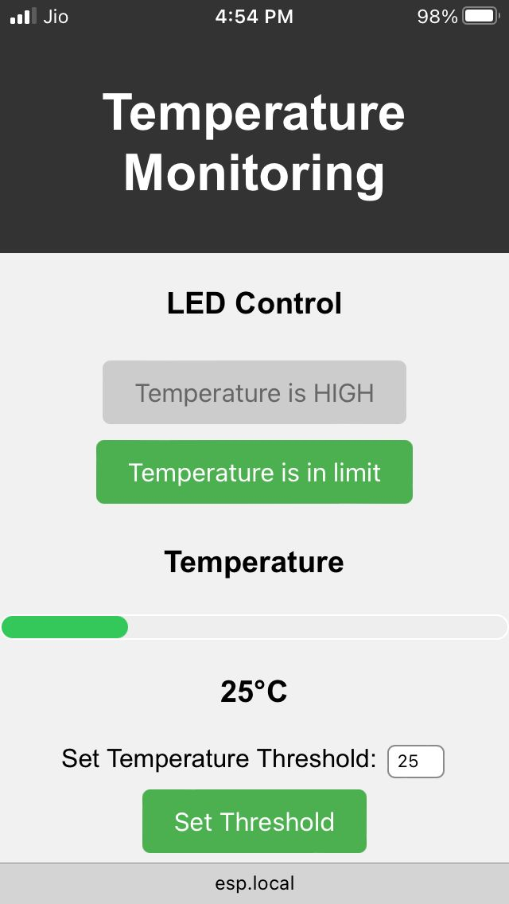
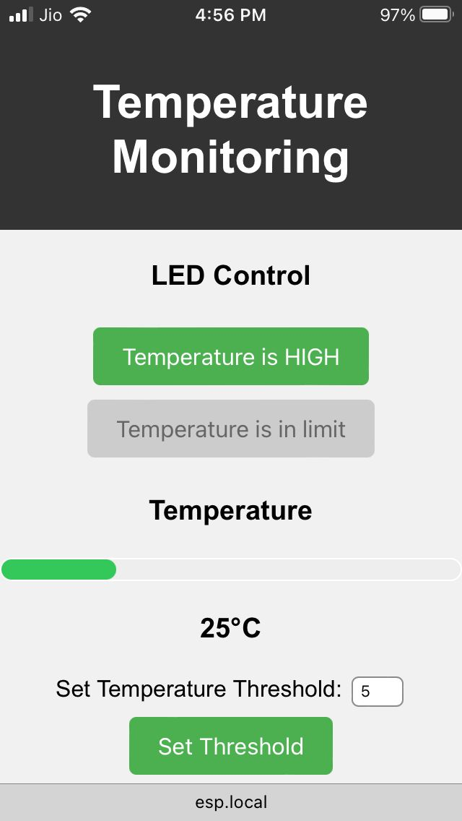
4.5 Results

Slide 31
Thank you

